Slide 1
CRASH DETECTIVES
Analyzing Killed or Seriously Injured Accidents
Toronto 2006-2020

Slide 2
INTRODUCTION
With the City growing, more cars on our streets, and traffic congestion has become a challenge.
Each year in Canada, about 2,000 people are killed and 165,000 are injured, (10,000 seriously) while using our road transportation system and costs society $37 billion (2.2% of Canadian GDP) annually. (Transport Canada, 2015, Draft Report on the Social Costs of Collisions in Canada, 1996-2012)
In Toronto alone, 100s of people were killed each year while trying to move around throughout the city. Bikers, pedestrians, children, and older adults were particularly vulnerable on the city’s streets.
In 2021, Toronto recorded a total of 63 traffic deaths, up from 46 in 2020 and 64 in 2019. Each year, pedestrians are the most vulnerable on the roads. Toronto lost 29 people who were walking in 2021, 23 in 2020 and 39 in 2019.
Using the data published by Toronto police this analysis review and analyze Killed and Seriously Injured Accidents and will join the date with red light locations.

Slide 3
OUR AGENDA/GOAL
The goal of this project is to investigate and determine what causes accidents and what attributes to their level of severity.
Through visualizations and machine learning algorithms, areas of concern will be highlighted, and the seriousness of accidents will be predicted as accurately as possible.

Slide 4



WHO DOES THIS PROJECT BENEFIT?
City Planners
Insurance Companies
Educating Pulic
Accurately analyzing accidents can help governments to better the safety of their roads and highways.
It can also be beneficial to insurance companies looking to change their rates in different areas.
Identifying high areas of accidents and high areas of accident severity can highlight areas of concern.

Slide 5
RESEARCH QUESTIONS
When do/did the most accidents happen?
How do the available factors contribute to accident seriousness?
Can we create a machine learning algorithm that correctly predicts the severity of accidents?
Can we forecast the number of accidents in upcoming years based on the information available?
What are the limitations of the current data?
What things would help this research to be more accurate?

Slide 6
DATA SET
City of Toronto's Open Data Portal- https://open.toronto.ca/dataset/
Seriously injured/killed collisions data : https://open.toronto.ca/dataset/motor-vehicle-collisions-involving-killed-or-seriously-injured-persons/
Red light cameras data :
https://open.toronto.ca/dataset/red-light-cameras/
Traffic collision data :
https://open.toronto.ca/dataset/motor-vehicle-collisions-involving-killed-or-seriously-injured-persons/
Killed & Seriously Injured Data Details
Accident Number
Road Class
Collector
Accident Location
Intersection
Location
Visibility
Expressway and ramps
Lane
Local
Major + minor arterials with ramps
Latitude
Longitude
Driveway
Overpass or bridge
Underpass or tunnel
Trail
Private driveway…
Clear
Fog, mist, smoke and dust
Freezing rain
Snow and Drifting snow
Strong wind…
Light
Daylight or dark
Dawn or dusk
Artificial lights…
Vehicle type
Manoeuvre
Automobile and station wagon
Motorcycle
Bicycle
Driver Action
Pick up truck
Street Car
School bus…
Turning left or right
Failed to yield right of way
Disobeyed traffic control
Lost control
Improper lane change
Speed too slow
Speed too fast for condition…
Stopped
Making U-turn
Overtaking
Changing lanes
Reversing …
Age of the involved
10 to 14
25 to 29
Over 95
15 to 19
20 to 24
……
Driver condition
Ability impaired, alcohol
Normal
Inattentive
Medical/physical disability
Fatigue
Ability impaired, drugs…
Accident class
Fatal
Non-fatal injury
Property damage
Time stamp
Year
Date
Time
Accident Identifier

Slide 7


TECHNOLOGIES USED
Data cleaning &
exploratory analysis
Database storage
Machine learning models
Dashboard
Pandas, numpy,
seaborn
Database storage:
PostgreSQL
Decision tree
Random forest
Gradient boosting
Tableau public

Slide 8
EXPLORATORY DATA ANALYSIS
More Fatal accidents in areas without Red Light
More accidents happen in the beginning of Summer and Winter
Weekends are more dangerous. Fridays are worse.

Slide 9
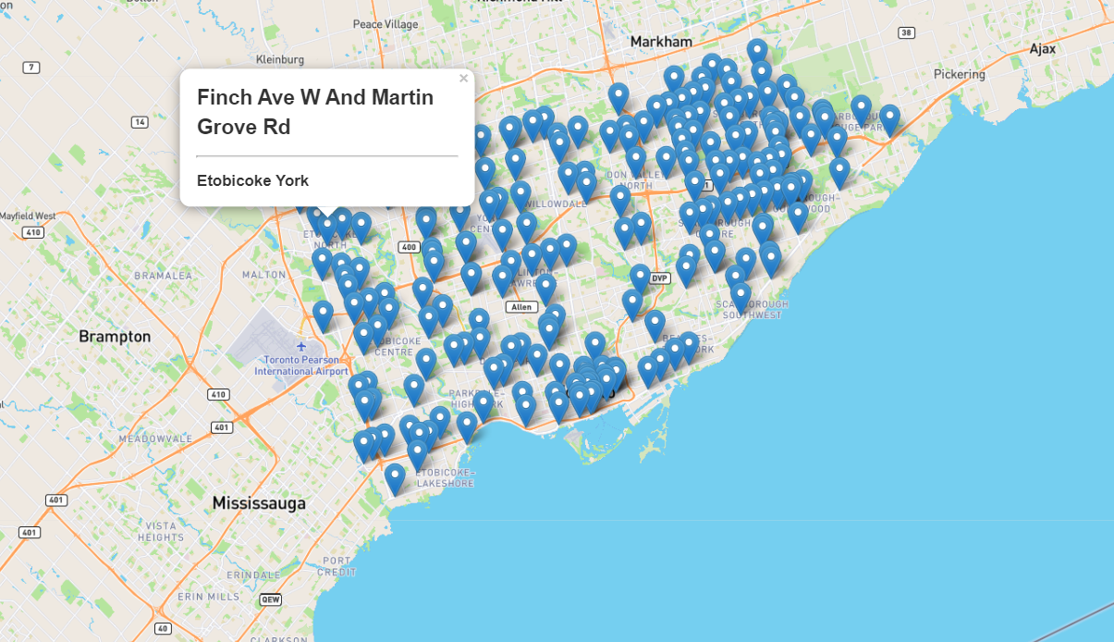
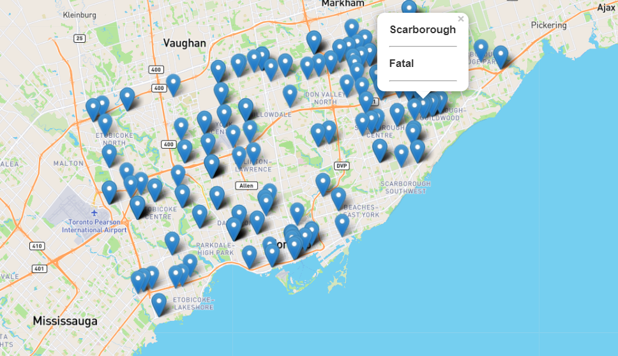
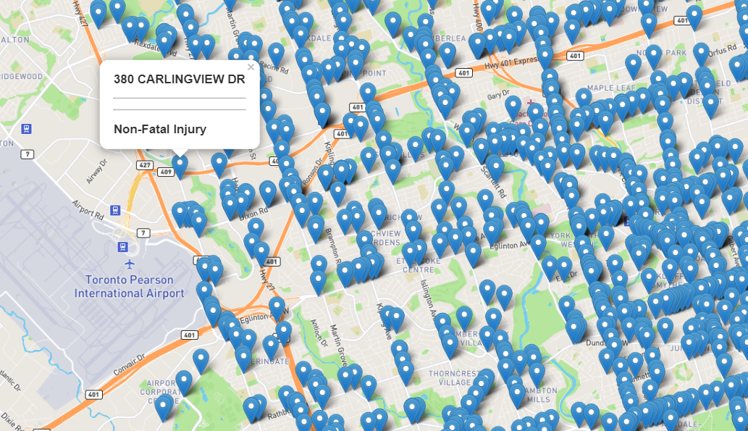
RED LIGHT CAMERA
Red Light Camera Locations
Accidents @ Red Light Camera Locations - Low Density
Accidents @ Locations Without Red Light Camera - High Density

Slide 10
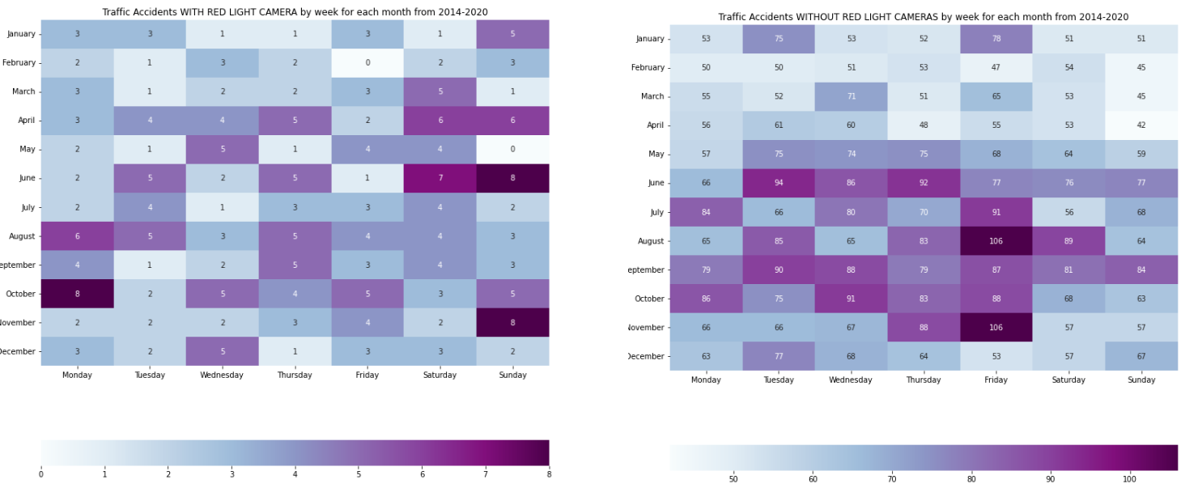
HEAT MAP FOR WITH & WITHOUT RED LIGHT CAMERAS

Slide 11
POSSIBLE SOLUTION
From the data above more controlled areas would be beneficial. Maybe signs alerting drivers of the upcoming junctions, traffic lights, or stop signs would help in some of these areas where they are feasible.
ADD MORE…..

Slide 12
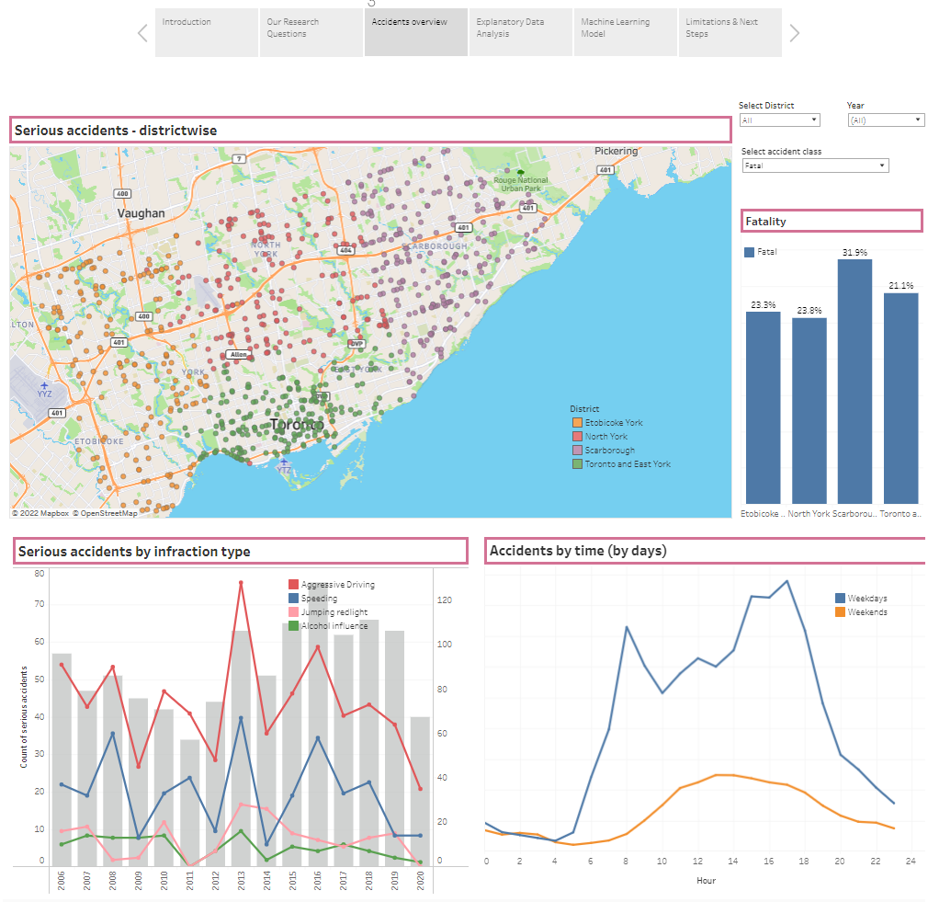
DASHBOARD
Access Dashboard HERE

Slide 13
Machine Learning
In our machine leaning approach, we will be using
Classification models
Random Forest and Gradient Boosting.

Slide 14
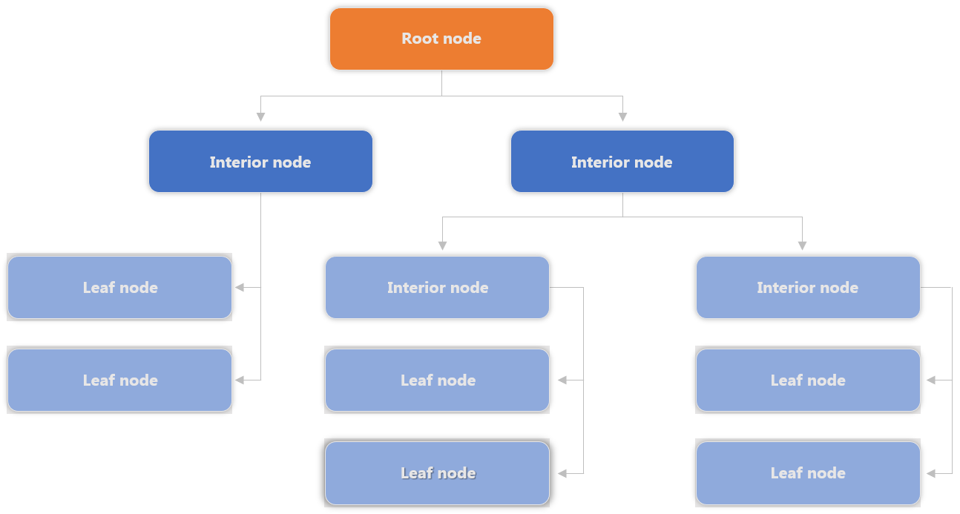
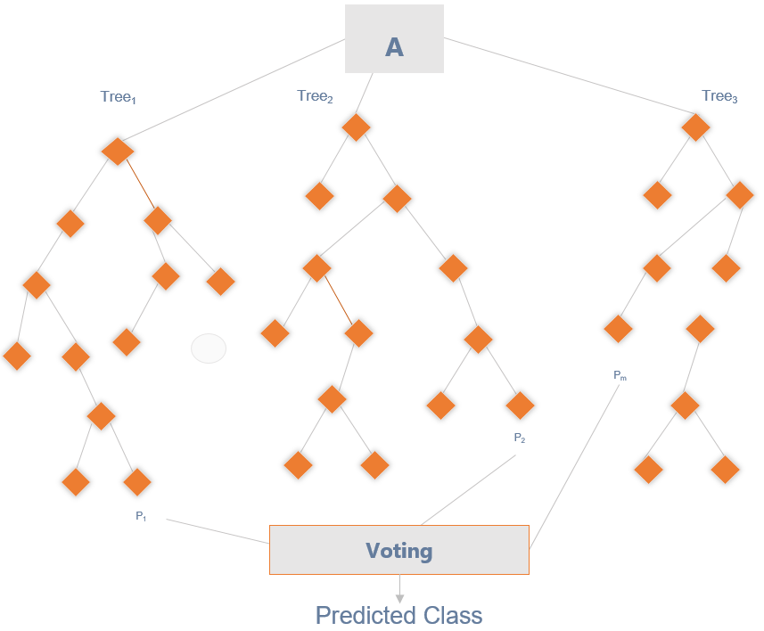
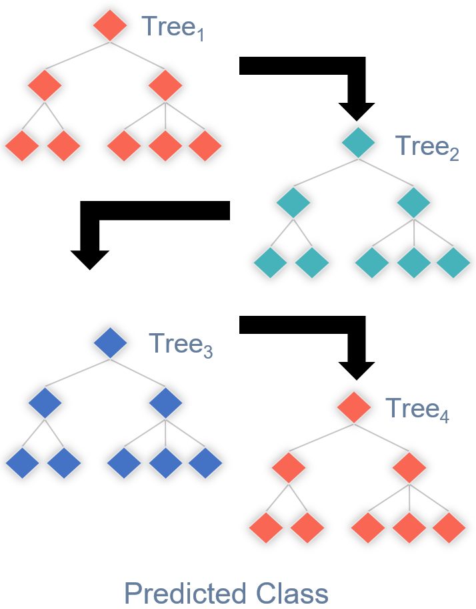
Models Options
Decision Tree
Random Forest
Gradient Boost
Benefits: An easy interpretive model. Easy to classify or label objects.
Drawbacks: It can become very large very quickly. Deep and complex trees tend to overfit to the data and does not generalize well.
Benefits: A random forest algorithm will sample the data and build several smaller, simpler decision trees. Has a reduced risk of overfitting.
Drawbacks: The main limitation of random forest is that a large number of trees can make the algorithm too slow and ineffective for real-time predictions. In general, these algorithms are fast to train, but quite slow to create predictions once they are trained.
Benefits: Works well with unbalanced classes. Boosting also can improve model predictions for learning algorithms. The weak learners are sequentially corrected by their predecessors, and, in the process, they are converted into strong learners.
Drawbacks: Sensitive to outliers since every classifier is obliged to fix the errors in the predecessors.
Notes:
https://www.entrepreneur.com/article/253169

Slide 15
Model Selection
Random Forest
As we know where the cameras are already installed, we will use the factors of the accidents at those locations to train our model to predict the location of red-light cameras based on the factors of traffic accidents. As there are many factors that affects a collision in an intersection, using a random forest enables feature randomness when building individual trees, to which the forest will make a more accurate prediction by committee.
Gradient Boosting
As major and more severe collisions occur infrequently compared to the whole scope of collisions, the model we build may hold some form of bias and skewness. In other words, the random forest may produce predictions solely on the factors that affect minor collisions. This would mean the false negatives could be locations where major accidents had occurred, and the camera could be impacting such collisions. Thus, we will also test and employ gradient boosting. Gradient boosting will weight the observations and put more weight on the major collisions and less on minor collisions as they will already be handled well during training. This should reduce the bias and skewness of the model.
Notes:
https://www.entrepreneur.com/article/253169

Slide 16

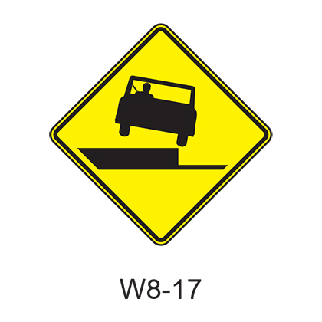
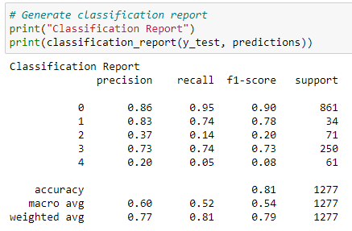
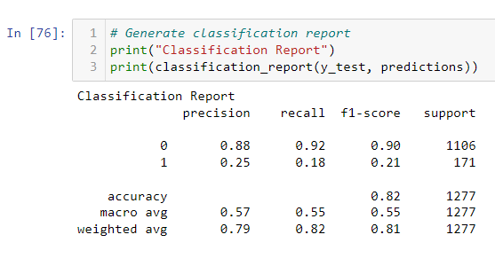
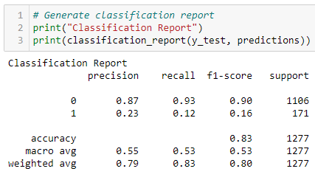
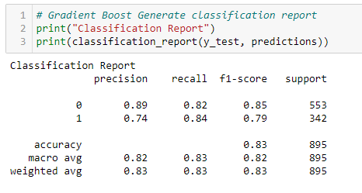
Machine Learning Process
Step
Step
Step
Step
Step
Run models with all data with injury type target
Target Accident Class
Refine Change encoding
Refine Remove Features
Success Use Over & Under-sampling
Results indicate over fitting and unclear results. Need to rethink the target. Pivot to use Accident Class.
Continued with label encoding. High F1, precision & recall on Non-Fatal predictions. Poor Fatal predictions.
Dig-in and make changes to remove any bias in the category encoding switch to one hot encoding from Label encoding
Remove features related to driver and focus on overall accident features
Correct class imbalance by over sampling fatalities and under sampling non-fatal accidents
Notes:
https://www.entrepreneur.com/article/253169

Slide 17
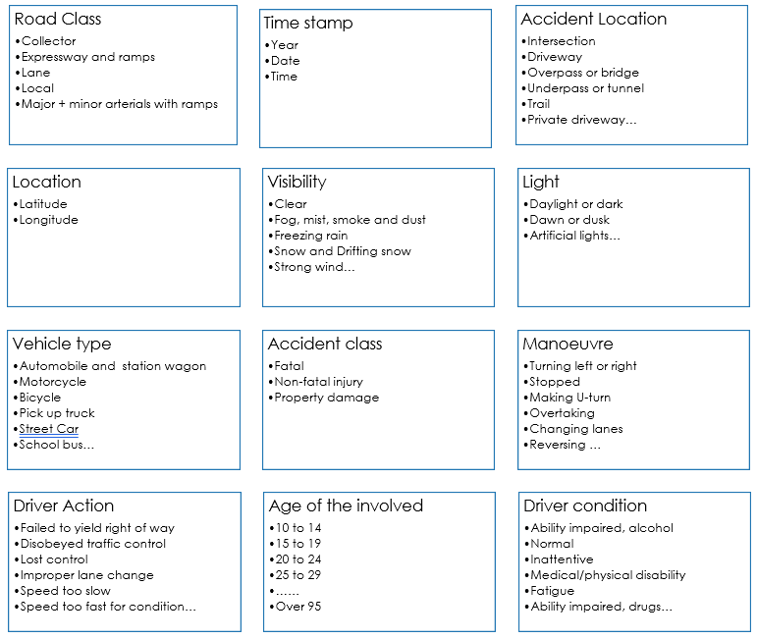
Machine Learning Process
The first stage involved keeping the majority of features with a few exceptions where the data could not be defined.
The data definitions for each raw file are found in the dataset folder
The models were pre-selected and include:
Random Forest
Gradient Boosted Tree
A size for the split into training and testing sets was not specified and therefore defaults to 25% with scikit-learn. Using Train_size or test_size the split can be specified.
The net result of this first run produced good performance on 3 of the 5 targets.
Step
Notes:
https://www.entrepreneur.com/article/253169

Slide 18
Machine Learning Process
This initial ML model run in step 1 was muddled. The some of the features were specific to the person involved in the accident and some of the features applied to the overall accident.
At this stage feature selection became very important. A decision was made to only run the model based on overall accident features and exclude individual participant features.
The target changed from Injury type (specific to the person) to Accident Class (specific to the accident)
Classification report shows High F1, precision & recall on Non-Fatal predictions however the model performs poorly on Fatal predictions.
Step
Notes:
https://www.entrepreneur.com/article/253169

Slide 19
Machine Learning Process
+
Step
Step
Refinement
These steps involved making additional decisions:
Based on feature importance rankings additional features which had no impact on results were dropped.
The encoding method was changed from Label Encoder to One Hot Encoder because some categorical columns had a high number of categories. This change ensured there was no ranking of the values because everything is a 1 or a 0 instead of a numerical range
Classification report shows no real improvement over step 2. There is still a high F1, precision & recall score on Non-Fatal predictions however the model performs poorly on Fatal predictions.
Notes:
https://www.entrepreneur.com/article/253169

Slide 20

Machine Learning Process
Class imbalance was having a big impact on the ML model performance where it was being skewed by the high number of non-fatal records
To correct for this over sampling and under sampling was employed through trial and error and included:
Randomly extracting 50 records of each target and running the ML
Under-sampling the non-fatal records
Over-sampling the fatal accidents
The best result was doubling the fatal records and cutting in half the non-fatal records.
Success at last…
The F1 scores on both fatal and non-fatal predictions is high
Precision and recall are equally good
Step
Notes:
https://www.entrepreneur.com/article/253169

Slide 21
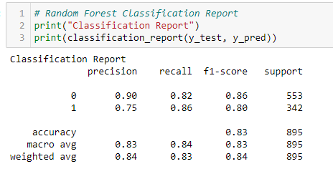

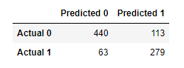
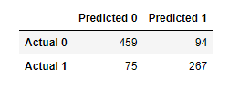

Results
Random Forest
Using the Model to Make Predictions
1
10 Intersection at 6pm
2
Input Speeding variable as Yes or No
3
Result: 6 out of the 10 intersections predict fatalities
Gradient Boost
4
Decision: Install Redlight camera or other controls
5
Iterate on other features to predict
outcomes
Notes:
https://www.entrepreneur.com/article/253169

Slide 22
Outcomes
Expectation | Reality
Overall I thought there would be certain features that had a high impact on the severity of accidents. - Mention the features that has high impact | There were very low/high correlations among features and accident severity. The highest correlation was WRITE FEATURE AND BY HOW MUCH

Slide 23
LIMITATIONS
Not able to obtain accuracy over 70% without causing other issues such as overfitting and bias.
The data was extremely imbalanced. The majority of accidents were not serious and while this is not a real life problem, it was a problem for this model. Undersampling was done to improve overall scoring.
More factors surrounding accidents should be included in this data.
Speed limits were missing
No information on cellphone usage of drivers
Correlations?????

Slide 24


The Team
ADITI
BARDHONIA
KRITIKA
RICHELLE

